Slide 1
Network Protocols, Encapsulation, and the OSI Model
John York
Shenandoah Valley Governor's School
Fall 2023

Slide 2
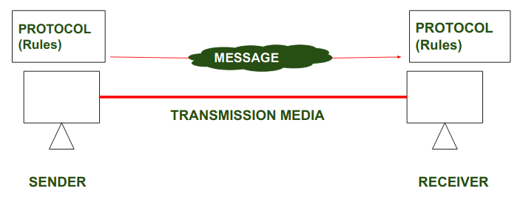
Protocols
Network protocols are sets of rules computers use to communicate
There are many, many protocols
Internet Protocol (IP)
Transport Control Protocol (TCP)
User Datagram Protocol (UDP)
Address Resolution Protocol (ARP)
…and more
https://www.geeksforgeeks.org/protocol-and-standard-in-computer-networks/

Slide 3
Layers and Models
Networking can be complicated, so take it in small bites
“Small bites” are called Layers
Ways of selecting and organizing Layers are called Models
Most common Models are:
OSI Model
TCP/IP Model

Slide 4
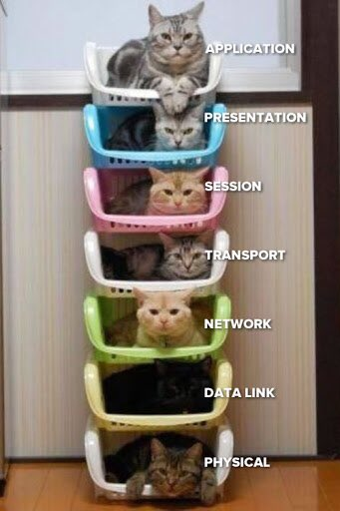
OSI Model
Oldest Model
Used by networking vendors
Some layers not used*
^{Application}
^{*Presentation}
^{*Session}
^{Transport}
^{Network}
^{Datalink}
^{Physical}

Slide 5
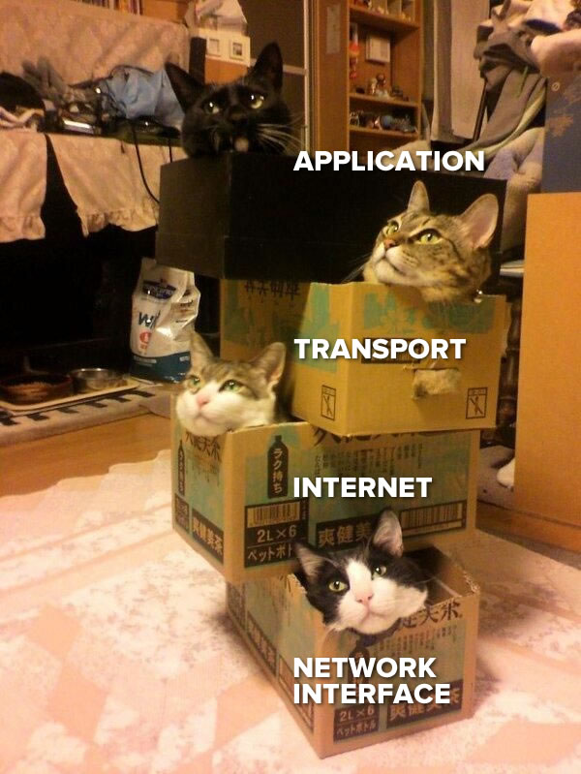
TCP IP Model
The TCP IP Model is simpler
Omits unused OSI layers
Presentation
Session
Also omits Physical layer
Since vendors mostly use OSI, we will use OSI as well
https://www.globalnerdy.com/2014/04/02/by-popular-demand-the-tcpip-layers-featuring-cats/

Slide 6
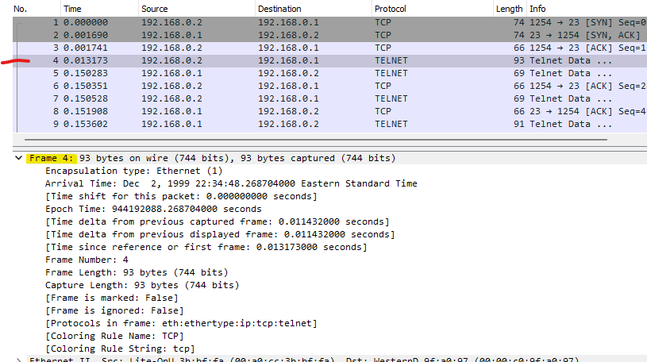
Wireshark and Layers
Wireshark records packets and breaks them into layers
The first one, FRAME, is not really a layer.
It is meta data about the packet created by Wireshark—times and stuff

Slide 7
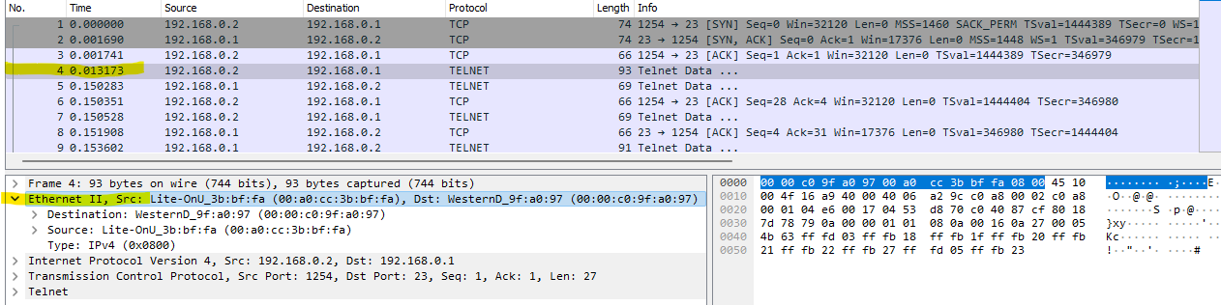
Wireshark—Data Link Layer
Data Link connects computers at the local level
Computers use Media Access Control (MAC) addresses
MAC is burned into your network/wireless card
Select a packet
MAC addresses
Raw data
Layer 2—Data Link
Next section is IPv4

